Slide 1

7-1 Project 2
DAT-430 Part Two
Anne Lankford
10/16/2022

Slide 2



Employee Contributing Factors
Age
Monthly Income
Total Years Working
Years at Company
Companies Worked For
Years in Current Role
Job Level

Slide 3

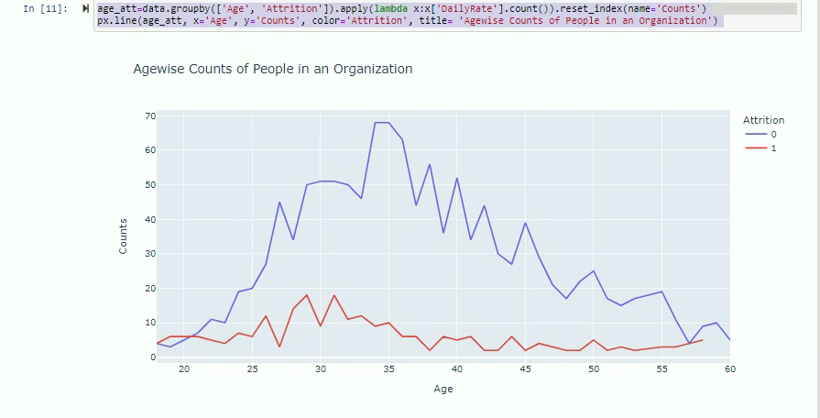
Age
The significant attrition rate is between ages 32 or younger, indicating the beginning of their career.

Slide 4
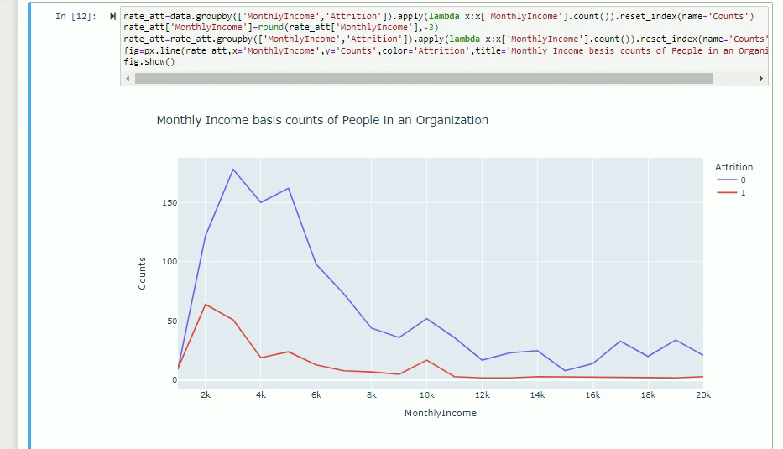
Monthly Income
The significant attrition rates by employees for monthly income are between $2,000 - $3,000 per month.

Slide 5
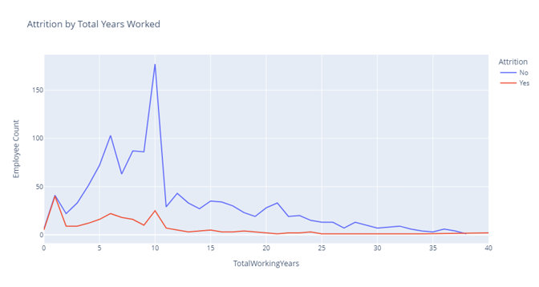
Total Years Working
The significant attrition rates for employees with 10 years or less of job experience

Slide 6
Years with Company
The significant attrition rate by employees with the company is 5 years or less

Slide 7
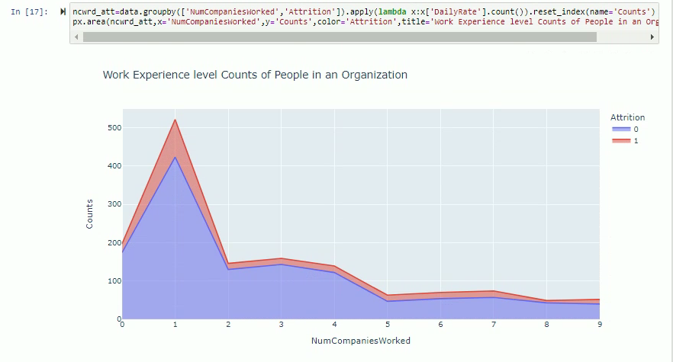
Companies Worked For
Most significant attrition by employees that have only worked for one company

Slide 8
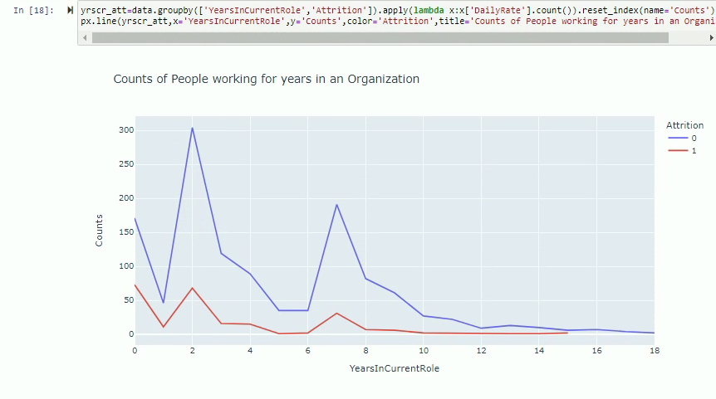
Years in Current Role
The significant attrition rates by employees who have worked in their current role for 2 years or less.

Slide 9
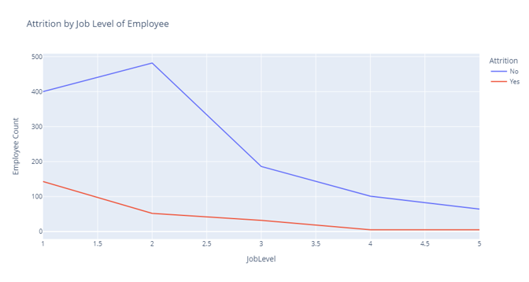
Job Level
The significant attrition rates for employees are for job levels between 1 and 2

Slide 10
Contributing Factors for Employee Attrition
It appears that the employees that experience the most significant attrition tend to be early in their career, in an entry-level position with lower income and limited experience at other companies.
Once employees develop more job skills, increase responsibilities, and income level, they tend to stay in their current roles with the company.

