Slide 1

Project Two:​
Gap Analysis & Proposal​
Presented by
Anne Lankford
Notes:
DAT 300 Project Two Presentation: Gap Analysis Proposal
Anne Lankford
12/09/2021

Slide 2

Gap Analysis​
Kansas City Warehouse
Notes:
Gap Analysis using Kansas City data and Warehouse dataset. The gap analysis also includes data from the monthly total spreadsheet.

Slide 3
Current and Future States
Current State
Kansas City Data is stored in the AS400 database resulting in errors during extraction of data to the Excel spreadsheet.
AS400 database is incompatible with the MSQL server.
Future State
Kansas City Data needs to be extracted and loaded into the MSQL server.
Formatted Kansas City Data needs to be free from errors and null values.
The data of the other facilities is being housed in the MSQL warehouse.
Future Kansas City Data needs to be loaded into the MSQL warehouse.
Notes:
The current state of the Kansas City data is not compatible with the MSQL server.
As a result of this incompatibility, there are errors and null values in the Excel spreadsheet showing up during the extraction.
The data for the other facilities are currently being housed within the MSQL warehouse.
The company would prefer to have all the data reside within one warehouse – the MSQL warehouse.
The Kansas City data needs to be reformatted and then loaded into the MSQL warehouse.

Slide 4
Identification of the Gap​
The Kansas City facility has stored its data in a database system that is now defunct. This has caused issues with validity and consistency.
There was a variation in the number of months of data that was extracted from the Kansas City dataset and the datasets of the other facilities.
The Kansas City data must be formatted, corrected, and loaded into the MSQL warehouse in conjunction with the other facilities.
Notes:
The existing database that is housing the Kansas City data is no longer viable.
This has caused problems with validity and consistency with the dataset.
The Kansas City data will need to be reformatted, corrected, and then loaded into the MSQL warehouse in conjunction with the rest of the other facilities.

Slide 5
Move From Current State to Future State​
Extract
Extract data from the AS400 database into Excel.
Format
Format cell data to match the formatting of the other facilities’ data. Use supplemental word document to correct and fill null and error values.
Process
Process data load from Excel spreadsheet to MSQL warehouse.
Create
Create a process to load future data from Kansas City Data into the MSQL warehouse.
Notes:
To move from the current state to the future state we will:
Extract the Kansas City data from the AS400 database
Format the Kansas City data to match the formatting of the other facilities. We will also use the supplemental word document to correct the null and error values.
Process the data from the Excel spreadsheet into the MSQL warehouse.
Create a procedure to load future data from Kansas City data into the MSQL warehouse.

Slide 6
Visualize the Gap Analysis​
Current State
Kansas City Data is incompatible with MSQL warehouse
Data in Excel contains null and error values
Data stored in Excel spreadsheet
Kansas City Data is in scientific format in the AS400 database
Gap Analysis
Extract data
Format data
Process data
Create process
Desired State
Extract data to spreadsheet
Ensure data is free from errors and null values
Move data to MSQL warehouse
Load future Kansas City Data into MSQL warehouse.

Slide 7
Summarize the Gap Analysis​
1. The analysis conducted has proven that in order to operate efficiently as a business, a warehouse storing the data of ALL facilities is crucial to accurate reporting and data analyzing in a timely manner.
2. Creating an ETL process would be beneficial as it allows for easier accessing and analyzing of data, and to make informed decisions more quickly and efficiently
3. Houston and Oklahoma City values have dropped significantly over the past two years. We should investigate why this is occurring or whether this data is accurate. Also, the value for the 28th month in Kansas City of 286 motors seems to be an outlier compared to the totals for the other months in Kansas City.
Notes:
The gap analysis has clearly shown that it will be beneficial to house all the data within one warehouse – especially since the Kansas City data is currently being housed in a non-viable location.
The ETL process is the most efficient way to achieve this. It will allow easy access and analysis of data.
The values for the Houston and Oklahoma City data have had a significant dropped over the past two years. It is prudent to determine the validity of these values.
During the gap analysis – we assigned data analysts to each of the steps along the process to ensure a smooth transition.

Slide 8
ETL (Extract, Transform, and Load) Process​
Extract
Extract the current data and use it to ensure that all current data is accurate, and no data has been repeated.
Transform
Transform the data so that we can ensure data is recorded accurately and free from errors.
Load
Load the data into the current MSQL warehouse accurately and keep it up to date.
Notes:
As noted, the ETL process is the best solution to move from the current state to the future state:
We will extract the Kansas City data from the AS400 database.
The data will be transformed so that we can ensure that the data is recorded accurately and free from errors.
Lastly, the data will be loaded into the current MSQL warehouse with the other facilities.

Slide 9

Sensitive or Confidential Information Handling ​
Although the information is not considered sensitive – it should still be housed on secure servers.
Only technicians that need to be working with the sales data should have authorized access.
By starting off on secure servers, if any information later is deemed sensitive then we are already set up for handling of sensitivity.
Encryptions should be put in place for future endeavors.
Notes:
The Kansas City datasets and Warehouse data contains only sales information in the form of monthly totals. It does not contain any personally identifying information and therefore is not considered sensitive.
The Kansas City data can still be considered confidential by company standards as it does contain sales data and they may not want the information leaked out.
As such, it should be housed on a secure server.
Only those technicians with the proper authorization and access should be working with the data.
Encryptions could be put in place for future endeavors, such as collecting additional sales information.

Slide 10

Proposal to Data Steward​

Slide 11
6 Key Responsibilities
Define the data
Create processes and procedures
Maintain quality of the data
Optimize workflows
Monitor data usage to assist teams
Ensure compliance and security of the data
Notes:
Define the data and identify assets within their data domains.
Create processes and procedures along with access controls to monitor adherence. This includes establishing internal policies and standards and enforcing those policies.
Maintain quality of the data using customer feedback, concerns, questions; internally reporting metrics; evaluating and identifying issues and coordinating and implementing corrections regularly.
Optimize workflows and communications.
Monitor data usage to assist teams, share best practice trends in data use and provide insight into how and where teams can use data to help in day-to-day decision-making.
Ensure compliance and security of the data. Data stewards are responsible for protecting the data while providing information on potential risks and offering regulatory guidance.

Slide 12
Issues Identified in Project One​
Kansas City data is stored in a defunct AS400 database that is incompatible with the MSQL warehouse.
Kansas City data initially shows null and error values.
Kansas City data missing month 28th – found to be added later.
Values loaded into excel are in the scientific format.
- Needs to be reformatted to match other facilities.
Notes:
The Kansas City data is being stored in a non-viable database that is incompatible with the MSQL warehouse.
The Kansas City data was missing month 28th – this was found to be added as an addendum.
The values that were loaded into the Excel spreadsheet are in scientific format. They will need to be reformatted before to match the other facilities.

Slide 13
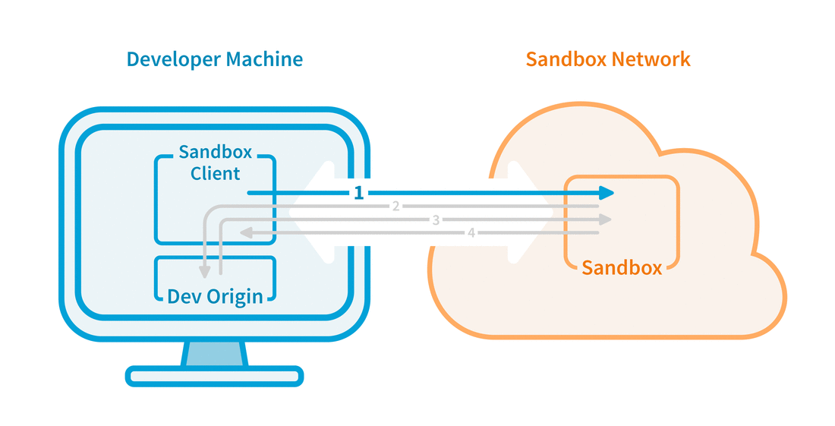
Production and Testing Environments​
Notes:
1. Sandbox environments are very similar to the Production build. Feature functionality is identical to the Production environment, except for Sync capabilities.
2. The Sandbox environment is used to execute untested code, or untrusted programs from unverified third-parties, suppliers, untrusted users, and untrusted websites.
3. Sandbox environments are important to the preservation of data integrity and should be supported for formatting and the loading of new data.
4. The Sandbox environment allows data to be manipulated and preserved without error.
A master copy of data should be secured and separated as a backup to prevent loss of data during the ETL process.
ETL process should be tested in the Sandbox environment then moved to the production environment if proven successful.

Slide 14
Additional Data Resources​
SWOT analysis
Additional Employees/Training
Nadler-Tushman model
Notes:
The SWOT (Strengths, Weaknesses, Opportunities, and Threats) analysis:
Identifies Strengths – It provides a clear view of your company’s strengths and allows you to build on them to meet your business objectives.
Identify Weaknesses – It reveals your weaknesses and provides a chance to reverse them.
Define Opportunities – Using this you can create your growth plans based on your strengths and weaknesses.
Discover Potential Treats – It helps you analyze possible threats to your business, and you can subsequently make necessary changes to the business policies and necessary actions.
Personnel may not be considered a data resource; however, they are necessary for the process to be successful.
Additional analyst will be needed to ensure a smooth transition from the current state to the future state is complete.
Training on the new MSQL warehouse server will be needed for current and future employees to ensure that everyone is up to speed on the overall process and procedures.
The Nadler-Tushman Model examines how business processes work together and how gaps affect the efficiency of the organization.
Identify operational gaps by analyzing the company’s operating system as one that transforms inputs into outputs.
Transformation encompasses the existing systems and project activities currently in place that convert input into output.
Focuses on how gaps in the outputs can point to problems in the inputs and transformation functions.

Slide 15
References
Hanna, K. T., & Sales, F. (2021, October 29). What is gap analysis and how does it work? SearchCIO. Retrieved December 9, 2021, from https://searchcio.techtarget.com/definition/gap-analysis
Kenton, W. (2021, September 3). Gap Analysis. Investopedia. Retrieved December 9, 2021, from https://www.investopedia.com/terms/g/gap-analysis.asp#:~:text=A%20gap%20analysis%2C%20which%20is%20also%20referred%20to,are%20on%20the%20right%20track%20to%20accomplishing%20them
Mosley, M. (2010). The Dama Guide to the data management body of knowledge: (DAMADMBOK guide). Bradley Beach (N.J.): Dama International.
The Ultimate Guide to Mastering Data Ownership and Data Stewardship. Cognopia. (2021, October 19). Retrieved December 9, 2021, from https://cognopia.com/data-stewardship-ultimate-guide/

